Slide 1
Concordia University BLDG 6561: BUILDING ECONOMICS 1 Instructor: Prof. Mazdak Nik-Bakht Presented by: Group 5
Student Name | Student ID
ADIT SINGH | 40046659
ANOOP CHANDER SINGARAPU | 40068830
DHRUVIN JAYANTIBHAI SAVAJ | 40042275
HARWINDER SINGH | 40047852
HETASVI JAVIYA | 40043457
VIVEKKUMAR CHATROLA | 40059267
NAGA SAI SASHANK GANTI | 40039505

Slide 2
Variable Investment In Commercial Sector

Slide 3
Problem Statement
We have selected four different alternatives of commercial buildings from all the available options which are to be analysed for a period of 20 years.
We must select the best one by comparing the alternatives through various economic analysis techniques on each of them.
Else we will consider a fifth alternative as an investment of $12 M in Scotia Bank with an interest rate of 2.5%

Slide 4
Assumptions
Decision horizon or time- period of 20 years.
The Income Tax Consideration from Revenue Canada.
Opportunity cost based on new construction in downtown.
Data that was necessary for the analysis which we could not find out.
We have selected Double Decline Method to find the terminal value.
We have selected the fifth alternative with an opportunity cost of 2.5%

Slide 5
Alternative:1 (Place Ville Marie 4)
Year of construction | 1962
Class | B
Total area | 75091
Total Initial Cost ($ M) | $22.50
Annual O&M cost ($ M) | $1.05
Overhaul cost ($ M) @every 6 year | $0.90
Revenue ($ M) per year | $4.51
Terminal value @ 20 year (DDB) ($ M) | $0.36

Slide 6
Alternative: 2 (16, Place Du Commerce, Verdun )
Year of construction | 1992
Class | A
Total area | 165000
Total Initial Cost ($ M) | $16.50
Annual O&M cost ($ M) | $1.07
Overhaul cost ($ M) | $1.04
Revenue ($ M) | $3.56
Terminal value @ 20 year (DDB) ($ M) | $0.29

Slide 7
Alternative: 3 (780, Rue Wellington)
Year of construction | 2010
Class | A
Total area | 188700
Total Initial Cost ($ M) | $21.25
Annual O&M cost ($ M) | $1.23
Overhaul cost ($ M) | $1.19
Revenue ($ M) | $4.53
Terminal value @ 20 year (DDB) ($ M) | $0.33

Slide 8
Alternative:4 (1360, Rene Levesque)
Year of construction | 1962
Class | B
Total area | 75091
Total Initial Cost ($ M) | $22.50
Annual O&M cost ($ M) | $1.05
Overhaul cost ($ M) | $0.90
Revenue ($ M) | $4.51
Terminal value @ 20 year (DDB) ($ M) | $0.36

Slide 9
Alternative:5(Do nothing)
Total Initial Cost ($ M) | $12
Interest rate | 2.5% (Scotia bank interest rate)
Duration | 20 year
Future value ($ M) | $19.66

Slide 10
Data information
Decision horizon | 20 Year
Bank Interest rate | 3.41%
Bond Interest rate | 5.72%
WACC(%) | 4.07%
Opportunity cost | 7.0%
MARR before tax | 7.0%
Income tax | 38.0%
MARR after tax | 4.34%

Slide 11
Net present worth
$4.42
$4.73
$5.21
$3.74
$4.73 M
A3
A4

Slide 12
INTERNAL RATE OF RETURN
Δ IRR= -1%
IRR=10.10%
IRR=9.58%
Δ IRR=1.83%
IRR=9.48%

Slide 13
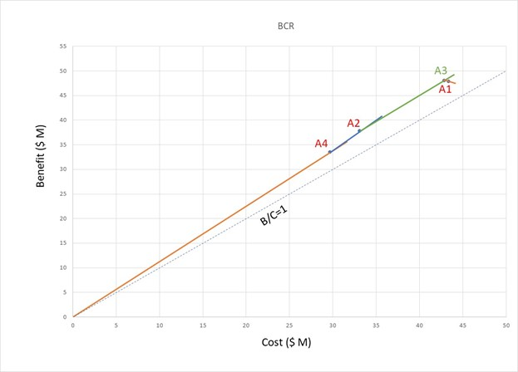
Benefit to cost ratio

Slide 14
Pay back period
10th year

Slide 15
After Tax Analysis
A3
A4

Slide 16
Sensitivity Analysis
Examined cash flows using spider graph and tornado graph to find out most influenced parameters
Uncertain parameters: Revenue, O&M cost, overhaul, MARR, Salvage value
We ran a sensitivity analysis for different deviation range
Uncertain parameters | Deviation range
Revenue | +/- 10%
O &M Cost | +/- 8 %
Overhaul Cost | +/- 5 %
MARR | +/- 30 %
Salvage Value | +/- 15%

Slide 17
Tornado Graph

Slide 18
Tornado Graph

Slide 19
Most Sensitive parameters
Most Sensitive Parameter
Revenue
MARR
Operational & Maintenance Cost

Slide 20
UNCERTAINITY BEHAVIOUR
PARAMETERS | DATA TYPE | DATA SOURCE | DATA BEHAVIOUR
MARR | Sample data | Historical Data of Alternative | Discrete
REVENUE | Subjective Data | Expert Judgement | Continuous
OPERATION & MAINTENANCE | Subjective data | Expert judgement | Continuous

Slide 21
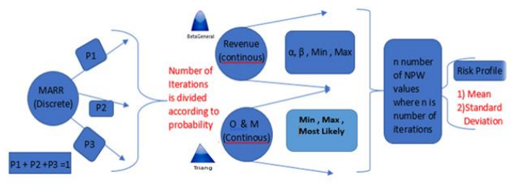
Simulation Procedure

Slide 22
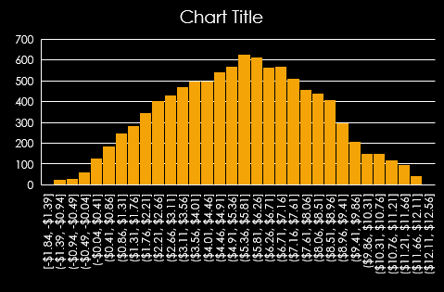
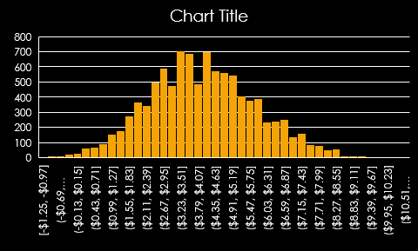
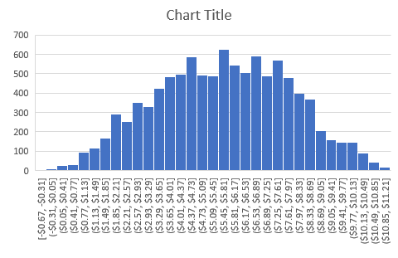
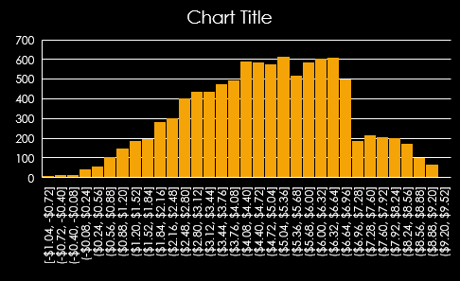
RESULTS
ALTERNATIVE 1
EV>2SD ; FALSE
ALTERNATIVE 2
EV>2SD ; TRUE
ALTERNATIVE 3
EV>2SD ; TRUE
ALTERNATIVE 4
EV>2SD ; FALSE

Slide 23
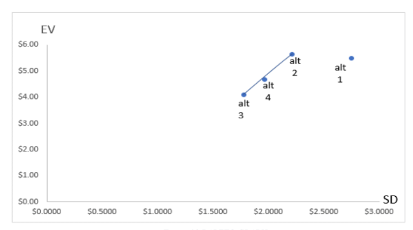
PARETO GRAPH

Slide 24
Conclusion
alternative 1 and alternative 4 can be discarded based on NPW and IRR
Alt 3 is More profitable than alternative 2 based on incremental IRR and BCR analysis also alternative 3 has the least Pay back period.
As after risk analysis, Alt 2 has more risk and more return but we want to be on safe side.
Therefore, Alternative 3 is selected.

